Slide 1
Discrimination
&
Mistreatment
Towards Transgender/
Gender Non-Conforming
Persons
in Shelters
Angela A. Russo
Public Policy Process
Summer 2019

Slide 2
Policy Analysis: The Stages Model
Issue Emergence
Alternative Selection
Implementation
Evaluation
Agenda Setting
Enactment
Notes:
Speaker: clearly thinking through the progression of pp. Timothy Castano
2012:
Through the 2012 rule HUD first sought to address significant evidence illustrating the extent of housing discrimination lesbian, gay, transgender, queer or questioning person's face when seeking housing. Under this ruling, HUD required all HUD-assisted, insured, and funded programs be made available to all eligible individuals and families regardless of sexual orientation, gender identity, or marital status.
2016:
Unfortunately, the 2012 rule didn’t address how temporary or emergency housing programs should accommodate, or place, transgender or gender nonconforming clients.
This is important because traditionally shelters are segregated by “male” and “female” floors and bathrooms or shower schedules. This also means people are typically placed according to their sex assigned at birth, or whatever is listed on their documentation.
Research shows when transgendered homeless are placed in this way they experience significant violence, discrimination, and harassment.
So, with the 2016 Rule, HUD requires programs be place these clients in housing that matches their gender identity or at least puts the decision into the clients hands.
The rule also requires program evaluate their policies relating to things such as intake, security, discrimination, or health policies to ensure the policies are designed in a way that discriminated, such as using different protocols, against this population.
It also explicitly states programs are prohibited from asking intrusive questions about a person’s anatomy or asking for medical evidence of someone’s identity.
------
The Fair Housing Act does not specifically include sexual orientation and gender identity as prohibited bases. However, discrimination against a lesbian, gay, bisexual, or transgender (LGBT) person may be covered by the Fair Housing Act if it is based on non-conformity with gender stereotypes.

Slide 3
Issue Emergence:
The Social Environment - Key Indicators
30% who had a job reported being fired denied a promotion....
Respondents were four times less likely to own a home (16%) compared to the U.S. population (63%).
15% were unemployed, 3x higher than the US rate at the time.
29% were living in poverty, compared to 12% of the US population.
23% reported housing discrimination
Notes:
Follow Trisha Teffenart: Focus on data first.
2015 TG survey conducted by the National Center for Transgender Equality
30% of respondents who had a job reported being fired, denied a promotion, or experiencing some other form of mistreatment in the workplace due to their gender identity or expression, such as being verbally harassed or physically or sexually assaulted at work.
46% of respondents were verbally harassed and 9% were physically attacked because of being transgender.
Nearly one-third (29%) of respondents were living in poverty, compared to 12% in the U.S. population. A major contributor to the high rate of poverty is likely respondents’ 15% unemployment rate—three times higher than the unemployment rate in the U.S. population at the time of the survey (5%).
Key learning from: give all the stats first.
. For example, the rule details that 100 calls made to shelters across four different U.S. state uncovered shelter staff asking the caller about their “genitalia or surgery requirements” in order to determine housing placement (Office of the Secretary, HUD, 2016).
40% of nations homeless youth, 18-24 young adults, are homeless. This means its particularly important that our shelter system is inclusive and aware of the needs of a population disproportionately impacted by homelessness.
Although now sharply divided, public attitudes toward LGB people do reflect greater acceptance today - with younger generations leading way
Support of same sex relations w/two adults changed dramatically from 70% thinking it “always wrong” (1973) to 44% (2010)
However, Transgender people remain far more marginalized, despite gains seen w/ LGB people
In a 2015 U.S. Transgender Survey of 27,715 transgender people:
77% experienced mistreatment or discrimination at work
30% report being fired or denied promotion
20% report illegal work activity at some point in lifetime to pay bills
23% report some form of housing discrimination
30% report homelessness in lifetime; 12% report homelessness in past yr – of those, 26% avoided shelters fearing mistreatment while 70% went to shelters report actually being mistreated; only 4% had + experience
59% avoided public restroom in past year to avoid harassment or violence
47% were sexually assaulted at some point in lifetime; 10% in past year
57% report feeling uncomfortable asking police for help against violence;
20%-40% of urban homeless youth are LGBT
“To Whom Do They Belong?: Runaway, Homeless and Other Youth in High-Risk Situations in the 1990’s”, The National Network of Runaway and Youth Services, Washington, D.C., 1991
Of the estimated 4,000 street youth living in NYC, about 1/3 (~1,300) are believed to be LGBT
Black youths account for nearly 50% of this LGBT total (about 600 youth); Latinx youths, 25% (325)
NYC Homeless Population Survey, July 2007
On average, LGBT street youth (as compared to their heterosexual counterparts) are:
More likely to have faced disapproval, abuse and neglect — and being thrown out of their homes rather than run away
Physically/sexually victimized by 7 more people prior to being homeless
More likely to bolt again after being returned home by the authorities
Have had nearly 2x as many sexual partners
Have used more dangerous substances more frequently
Often harder to find supportive permanent placements once placed into foster care system, extending their length of time in the system
more likely to be criminally charged and punished more harshly for violations of age-of-consent laws
More likely to face selective enforcement of “quality of life” offenses and “morals” regulations congregating in public places, especially if they are LGBT youth of color
From “Challenges Faced by Homeless Sexual Minorities: Comparison of Gay, Lesbian, Bisexual, and Transgendered Homeless Adolescents with their Heterosexual Counterparts,” Cochran, B. N., Stewart, A., Ginzler, J. A., & Cauce, A. M., American Journal of Public Health, Vol. 92, 2002.

Slide 4
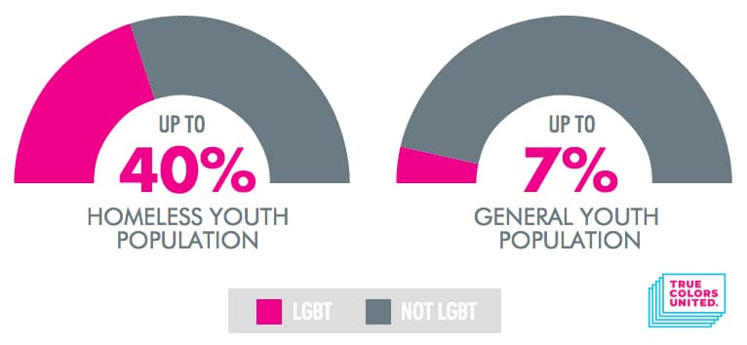
Issue Emergence: The Social Environment - Aggregate Data
Notes:
In total, some researchers say TG are 20 TIMES as likely to experience homelessness

Slide 5
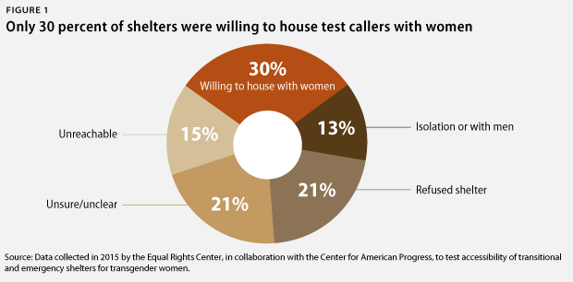
Agenda-Setting: Evidence-Based Policymaking & National Mood
Official Actors: Policymakers, HUD
Unofficial Actors:
LGBTQ groups,
housing advocates,
homelessness field, media
Notes:
Official Actors: key policymakers and agencies such as HUD.
Unofficial: LGBTQ groups, housign advocates, homelessness field, communication media
https://www.americanprogress.org/issues/lgbt/reports/2016/01/07/128323/discrimination-against-transgender-women-seeking-access-to-homeless-shelters/
Power of opening with stats:
Rule we will later discuss includes this data: Research conducted by the Center for American Progress to test accessibility of shelters for TG women. They made 100 calls to shetlers across 4 US states.
Also, “genitalia or surgery requirements” in order to determine housing placement (Office of the Secretary, HUD, 2016).
The test caller was told that she would be isolated or given separate facilities at the shelter.
Ashelter employee misgendered the tester or made other statements to discredit her identity
26% of those who experienced homelessness in the past year avoided staying in a shelter because they feared being mistreated as a transgender person.
70% respondents who stayed in a shelter in the past year reported some form of mistreatment, including being harassed, sexually or physically assaulted, or kicked out because of being transgender.

Slide 6
Alternative Selection & Enactment:
HUD’s Equal Access Rule
2012 RULE: “Equal Access to Housing in HUD Programs Regardless of Sexual Orientation or Gender Identity”
2016 RULE: “Equal Access in Accordance With an Individual’s Gender Identity in Community Planning and Development Programs”
Issue Advocacy: HUD’s SNAPS Department
Notes:
Other alternatives: Proposals for constitutional and Statutory protection for SO and GI, local policies and ordinances. Ex: Hudson and JC’s policies (similar to Sheila cowley’s response to the force report, can take data into her own hands regardless of whether formal policies are established.)

Slide 7
Design & Implementation:
HUD’s Equal Access Rule
Goal - HUD programs will be accessible to all
Causal Model - Discrimination is the only reason for population not seeking shelter
Tool - Coercive policy, OPM
Target - Shelter staff
Implementation - Top-down approach
Notes:
Codification at the regulatory level. - HUD utilized its executive branch powers and influence as a funder to create coercive policies.
Interest groups used the power of Administrative Procedures Act to influence 2012 back to the decision agenda, creating 2016.
------
The Fair Housing Act does not specifically include sexual orientation and gender identity as prohibited bases. However, discrimination against a lesbian, gay, bisexual, or transgender (LGBT) person may be covered by the Fair Housing Act if it is based on non-conformity with gender stereotypes.

Slide 8
Ideological Agenda-Setting: HUD’s Proposed FR-6152
Explicit law vs. Implicit law
Is the causal theory just shelter staff?
Disrupts 2012 and 2016 Equal Access process, outcomes,
& Implementation
Notes:
SENATE PRESIDENT SWEENEY -Frustration when a bill is stalled or veto’ed.
“Notice of Proposed Rulemaking”
Religious views
Can refer to sex as identifiedi n government documentation
Ideological - removed LGBTQ website and related materials, stopepd researched, proposed this.
Also highlights that the overall issue isnt just shelter staff discrimination, its wider than the shelter and also signs for the lack of explicit stateent of law stating discrimination against sexual or or gen ide is wrong. This part of govt use (or abuse) of their authority reminds me of the anger Senate President Sweeney displayed last week. HUD’s EA rules took so many years and trainined rolled out nationally. Programs changed. Then to have the current admin come out, publicly, encdorsing LGBTQ discrimination is not only infuriating to public admisntirators and PA who have worked on this but forces the population further away from shelters.

Slide 9
Recommendation
Statutory Changes: Add “sexual orientation” and “gender identity” to the Fair Housing Law, as a protected class
Ongoing local advocacy: Interest groups and street-level bureaucrats as advocates by adding protective policies into their OPMs.
Notes:
Codification at the regulatory level. - HUD utilized its executive branch powers and influence as a funder to create coercive policies.
Interest groups used the power of Administrative Procedures Act to influence 2012 back to the decision agenda, creating 2016
------
The Fair Housing Act does not specifically include sexual orientation and gender identity as prohibited bases. However, discrimination against a lesbian, gay, bisexual, or transgender (LGBT) person may be covered by the Fair Housing Act if it is based on non-conformity with gender stereotypes.

Slide 10
http://legacy.glad.org/youth/genderidentity

Slide 11
References
Birkland, Thomas, A. (2016), An Introduction to the Policy Process: Theories, Concepts, and Models of Public Policy Making (4th Edition).
New York, New York: Routledge
Executive Office of The President. (2019) Revised Requirements Under Community Planning
and Development Programs (FR-6152) Retrieved from https://www.reginfo.gov/public/do/eAgendaViewRule?pubId=201904&RIN=2506-AC53
National Center for Transgender Equality (2015) 2015 U.S. Trangender Survey Report Retrieved from
https://transequality.org/sites/default/files/docs/usts/USTS-Full-Report-Dec17.pdf
Office of the Secretary. (2016) Equal Access in Accordance With an Individual’s Gender Identity in Community Planning and
Development Programs. HUD. (2016) Vol. 81. No. 183. (codified at 24 CFR Part 5)
Office of the Secretary. (2012) Equal Access to Housing in HUD Programs Regardless of Sexual Orientation or Gender Identity. HUD.
(2012) Vol. 77. No. 23. (codified at 24 CFR Parts 5, 200, 203, 236, 400, 570,574, 882, 891, and 982

